Slide 1
Mining pools

Slide 2
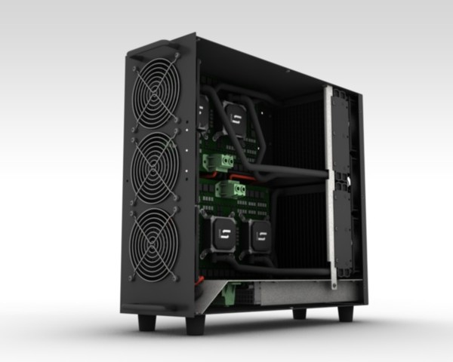
Economics of being a small miner
Cost: ≈US$6,000
Expected time to find a block: ≈14 months
Expected revenue: ≈$2,000/month
TerraMiner IV

Slide 3
Computing the revenue for each miner:
The pool manager chooses the new transactions that are going to be inserted, assemble the Merkle tree including the coinbase transaction that creates new coins towards himself.
The block header will be sent to all of the participants in the pool. The miners have to prove that they been working on it by sending in shares showing that they have been hashing this block. Finally one of the miners, hopefully in the pool, finds a valid block that will be published.
After this happens, all the miners will send the pool manager all the shares found. He will verify them and distribute the revenue proportionally to how much work they actually did.

Slide 4
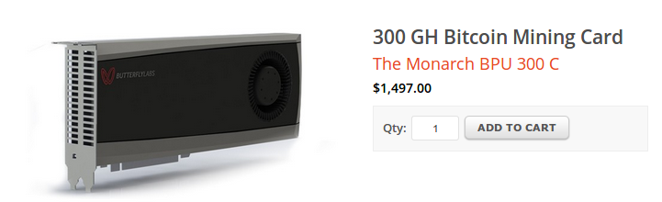
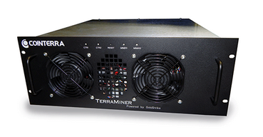
Mining pools
Hey folks! Here’s our next block to work on
Pool manager
prev: H( )
So it would have been better if he had just mined alone. While, the miner on the left would be glad since he will receive a higher reward.
coinbase:
25→pool
mrkl_root: H( )
$$$
nonce:
hash:
$$
0x00000000000a877902e...
$
0x000000000001e8709ce...
0x00000000000000003f89...
0x00000000000490c6b00...
0x0000000000007313f89...
0x0000000000045a1611f...

Slide 5
1.Pay-Per-Share (PPS) Model
Miners receive fixed payments for each share submitted, regardless of whether the pool finds a block or not.
How It Works
The pool calculates the expected block reward based on difficulty.
Miners receive a fixed payout for every valid share they submit.
The pool keeps transaction fees and takes on all risk.
Pros:
✅ Stable earnings – Miners get predictable payouts. ✅ No variance risk – Earnings don’t depend on luck.
Cons:
🚫 Higher pool fees – Pools take a percentage to cover payout risks. 🚫 Less incentive for miners to optimize work – Since rewards are guaranteed, miner efficiency doesn’t impact payouts.
Best For: Miners who prefer consistent and predictable income.

Slide 6
2. Proportional Model
Miners are paid based on the number of shares they submit before the pool finds a block.
How It Works
The total rewards from a mined block are divided proportionally among all miners based on their contribution.
Unlike PPLNS, all shares count (not just the last N shares).
If the pool takes a long time to find a block, earnings decrease.
Pros:
✅ Fair distribution – Miners are paid fairly based on their work. ✅ Lower variance than PPLNS – Because all shares count, not just the last N.
Cons:
🚫 Less stable than PPS/FPPS – Payouts depend on when blocks are found. 🚫 Susceptible to pool hopping – Miners might join a pool right before a block is found to maximize profits.
Best For: Miners who prefer fair payouts but can tolerate some variance.

Slide 7
3. FPPS (Full Pay-Per-Share) Model
FPPS is an improved version of PPS where miners also get a share of transaction fees.
How It Works
Works like PPS, but the pool also includes a share of transaction fees from mined blocks.
Miners earn higher payouts since they get both block rewards + transaction fees.
Pros:
✅ Higher earnings than PPS – Includes transaction fees. ✅ Predictable payments – No dependency on luck.
Cons:
🚫 Even higher pool fees than PPS – Because pools pay transaction fees upfront.
Best For: Miners who want steady income and transaction fee benefits.

Slide 8
4. PPLNS (Pay-Per-Last-N-Shares) Model
Miners get paid based on the last N shares submitted before a block is found.
How It Works
Instead of paying for each share, the pool only pays when a block is successfully mined.
Miners are rewarded based on how much work they contributed in the last N shares before a block is found.
Pros:
✅ Higher rewards when the pool is lucky – No fixed payouts mean more profit when blocks are found. ✅ Lower pool fees – Because the pool only pays when blocks are mined.
Cons:
🚫 High variance – If the pool goes through a bad luck streak, miners may earn nothing for some time. 🚫 Unstable income – Payments are inconsistent, depending on the pool’s block-finding success.
Best For: Experienced miners who can handle payout fluctuations.

Slide 9
PPS vs. FPPS vs. PPLNS vs. Proportional
Feature | PPS (Pay-Per-Share) | FPPS (Full Pay-Per-Share) | PPLNS (Pay-Per-Last-N-Shares) | Proportional
Payout Frequency | Fixed for each share | Fixed + transaction fees | Only when a block is mined | Only when a block is mined
Includes Transaction Fees? | ❌ No | ✅ Yes | ❌ No (or partial) | ❌ No
Risk Level | ✅ Low | ✅ Low | 🚫 High | 🚫 Medium
Earnings Stability | ✅ Very stable | ✅ Stable & higher | 🚫 Unstable | 🚫 Fluctuates
Pool Fees | 🚫 High (2-4%) | 🚫 Very high (3-5%) | ✅ Low (1-2%) | ✅ Low (1-2%)

Slide 10
Pool Hopping Attack
Clever miners may switch between pools to maximize earnings.
They join proportional pools early, then switch to pay-per-share pools later.
More advanced payout schemes like "Pay Per Last N Shares (PPLNS)" try to prevent this.

Slide 11
Alternative reward methods:
A lot of variations on the model explained above to compute the miners' reward
Pay-per-share:
The pool manager pays a flat fee for every share above a certain difficulty that the miners find.
In some ways it's the best for miners because the reward is guaranteed.
The pool manager is taking all the risk in this scheme, since he will have to pay even if no valid block was found for the current round. In this case the miners don't have any real motivation to send valid blocks, since they will get the same reward as if they have only found shares.
Proportional model:
instead of a flat share, the amount of share depends on whether or not the pool actually found a valid block.
In this case the miners still have some risk, while it will be lower for the pool manager. In this case, the miners have a higher motivation to send valid blocks.

Slide 12
Luke-Jr approach:
The pool owner actually collects no fee, but miners can't receive any revenue until their balance is at least one Bitcoin. So it's the best model to be in after the first Bitcoin, But it's harder to start to earn something. Since it's quite difficult to reach one Bitcoin nowadays, there are few systems that use this model.

Slide 13
Mining pool history
First pools appear in late-2010
Back in the GPU era!
By 2014: around 90% of mining pool-based
June 2014: GHash.io exceeds 50%

Slide 14
China - 81%
Czech Republic - 10%
Iceland - 2%
Japan - 2%
Georgia - 2%
Russia - 1%

Slide 15
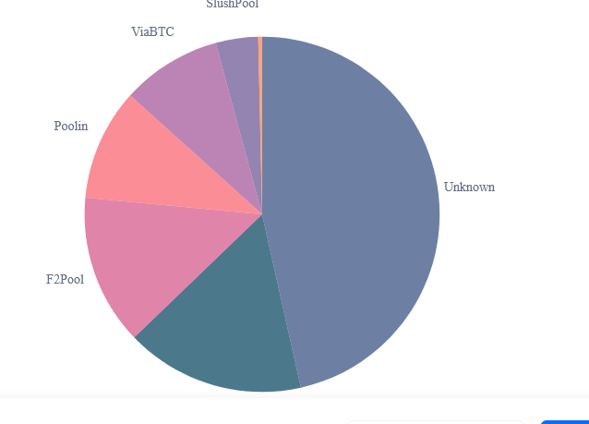
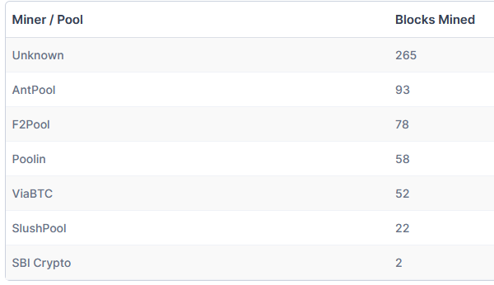
Hashrate Distribution
An estimation of hashrate distribution amongst the largest mining pools.
https:\\www.blockchain.com/pools
The graph shows the market share of the most popular bitcoin mining pools. It should only be used as a rough estimate and for various reasons will not be 100% accurate. A large portion of blocks are grouped into the 'Unknown' category. This does not mean an attack on the network, it simply means we have been unable to determine the origin. The table below shows a detailed breakdown of the most recent blocks mined.

Slide 16
Current Bitcoin Mining Pool Market Share
Mining Pool | Market Share | Hashrate (EH/s) | Payment Method
Foundry USA Pool | ~30% | 145.8 | FPPS
AntPool | 24.52% | 145.8 | FPPS
ViaBTC | 12.91% | 76.8 | PPS
F2Pool | 12.21% | 72.6 | PPS
Binance Pool | 4.9% | 29.2 | FPPS
MARA Pool | 3.7% | 22 | PPLNS
BraiinsPool | 2.5% | 14.9 | PPLNS
BTC.com | 1.6% | 9.5 | FPPS
Luxor | 1.5% | 8.9 | FPPS
SBI Crypto | 1.4% | 8.3 | FPPS
Data sourced from Hashrate Index and CoinBureau

Slide 17
51% Mining Pools & Network Centralization
By 2014, GHash.io controlled over 50% of the Bitcoin network hash power, causing centralization concerns.
The community pressured GHash.io to limit its size.
"Laundering hashes": Some large miners spread their power across multiple pools to hide their true size.
Mining Pools vs Cloud Mining
Mining pools are for people who have mining hardware to split profits.
Many people get mining pools confused with cloud mining. Cloud mining is where you pay a service provider to miner for you and you get the rewards.

Slide 18
Pros
Make mining more predictable(Reduces variance for miners.)
Allow small miners to participate
More miners using updated validation software(Simplifies network upgrades since pools control many miners)
Cons
Lead to centralization(few pools control most hash power).
Discourage miners from running full nodes
mining pools existance lowers the population of people actually running a fully validated Bitcoin node. Before mining pools, all small miners had to store the whole blockchain and validate transactions. Now, most miners offload that task to their pool manage

Slide 19
https://www.buybitcoinworldwide.com/mining/pools/

